Slide 1

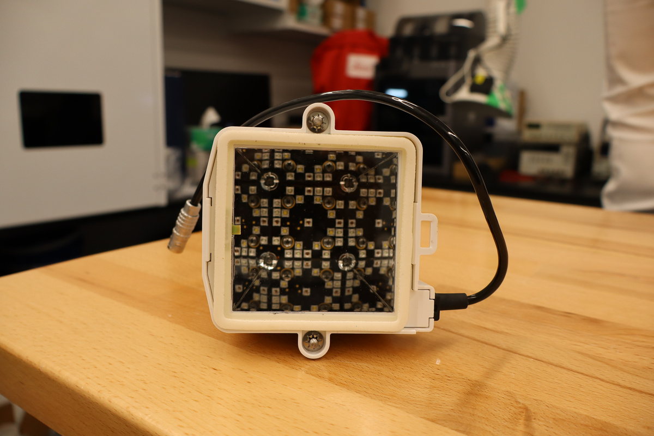
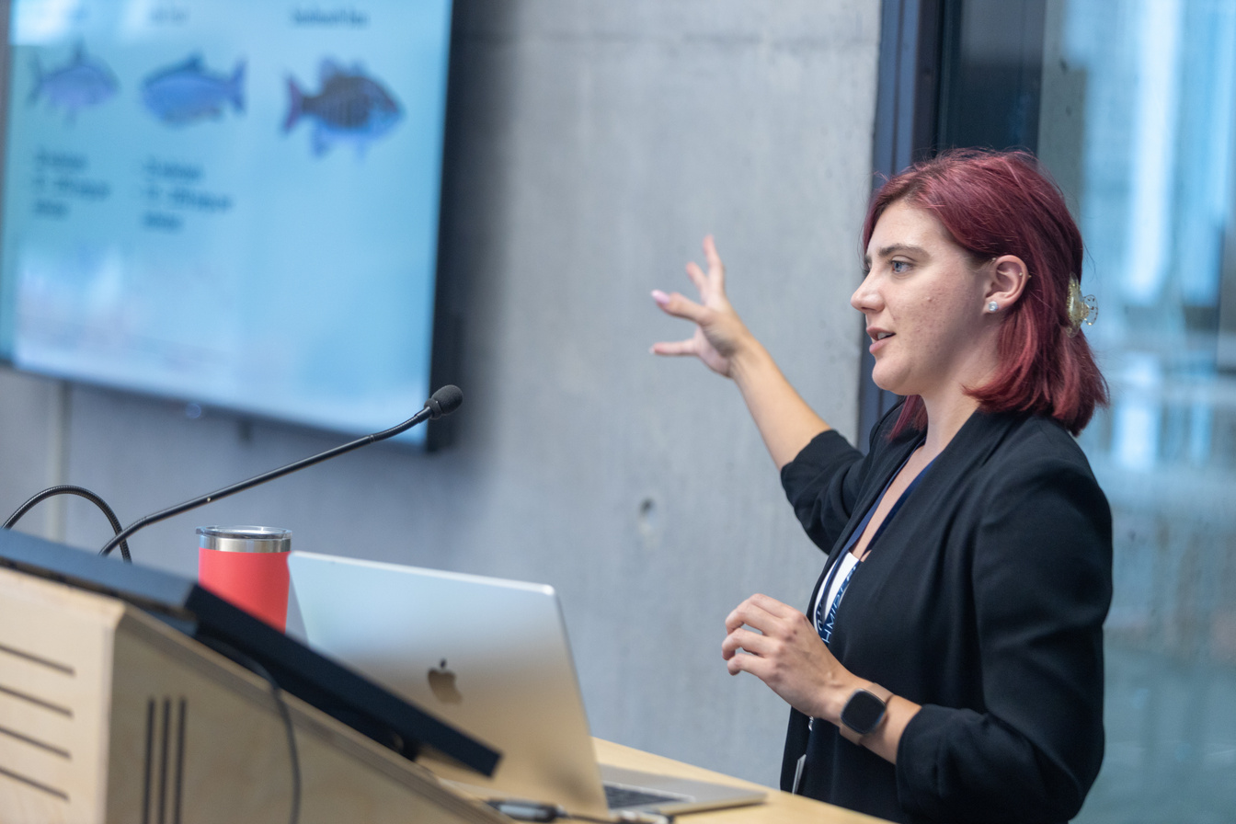

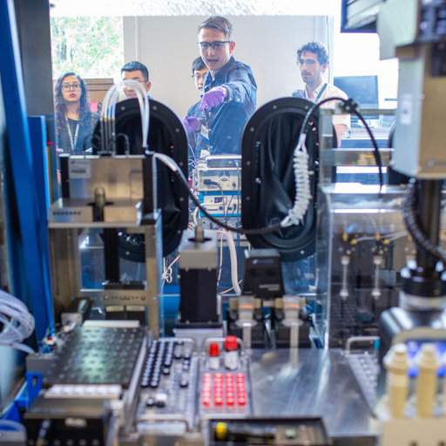
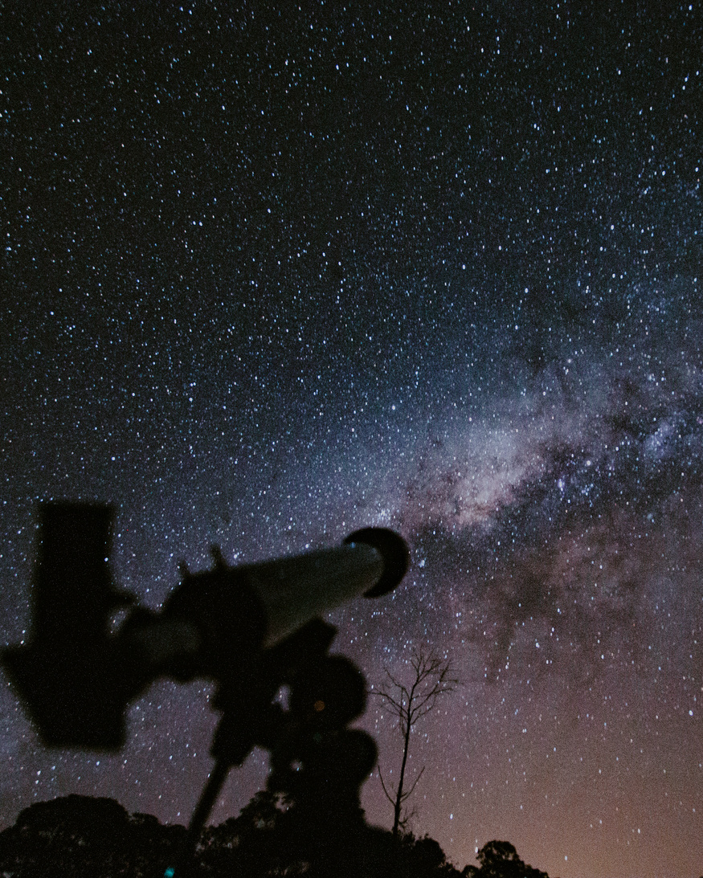


The Eric and Wendy
SCHMDT AI IN SCIENCE
Postdoctoral Fellowship
Solving Hard Problems with AI. The next generation of AI experts are here.
Apply by: October 8, 2025
Questions: schmidtfutures@utoronto.ca | Guidelines: schmidtfellows.utoronto.ca

